Slide 1








MLION — Machine Learning Incident-Ops Navigator
RISK
From 27 years of free-text incident descriptions to named root-cause families — Machine Learning, with a GenAI finish
THE CHALLENGE
357K
27 yrs
107
~0.6
Every OpRisk incident carries a rich free-text description that is stored but never analysed at scale. The Basel taxonomy alone cannot show which root causes keep recurring.
incidents analysed
of history (since 1999)
root-cause families
silhouette (separation)
MACHINE LEARNING
GENERATIVE AI
1. Prepare
2. Embed
3. Reduce
4. Cluster
5. Label
translate + clean
all-mpnet-base-v2
PCA + UMAP
HDBSCAN
LLM
›
›
›
›
Descriptions in French and Italian are translated to English and cleaned.
An NLP model turns each text into a vector that captures its meaning.
The vectors are compressed, keeping the structure and dropping the noise.
Incidents describing the same problem are grouped, however they are worded.
An LLM reads each cluster and names its root-cause family.
THE GENAI STEP — FROM A CLUSTER TO A NAMED FAMILY
WHAT IT BRINGS
Cluster profile (input)
Named family (output)
Grouping by meaning, not keywords
›
LLM
›
Key terms: kyc, pep, recertification, access rights…
+ 5 representative incidents
Label: KYC / PEP recertification
Root-cause family: Process & controls
Patterns that cut across Basel event types
Readable families, ready for analyst validation
BNP PARIBAS
The bank for a changing world
Classification : Internal
Notes:
MLION in one page. The starting point: every operational risk incident comes with a free-text description. These are stored but never analysed at scale, and the Basel taxonomy alone cannot tell us which root causes keep coming back.
The pipeline has five steps. The first four are machine learning. We translate and clean the descriptions. An NLP model turns each one into a vector that captures its meaning. We compress those vectors. Then a clustering algorithm groups the incidents that describe the same problem, even when they are worded differently.
The fifth step is the GenAI touch. A cluster on its own is just a number. So we give an LLM the profile of each cluster, meaning its most distinctive terms and a few representative incidents, and it returns a readable label and a root-cause family.
What it brings: incidents are grouped by meaning rather than keywords, the families reveal patterns that cut across Basel event types, and the output is readable, so analysts can validate it directly. Next step: analyst validation of the labelled families.
TO UPDATE BEFORE PRESENTING (made-up or unconfirmed values): the 107 families and ~0.6 silhouette figures, and the KYC / PEP example with its root-cause family.

Slide 2
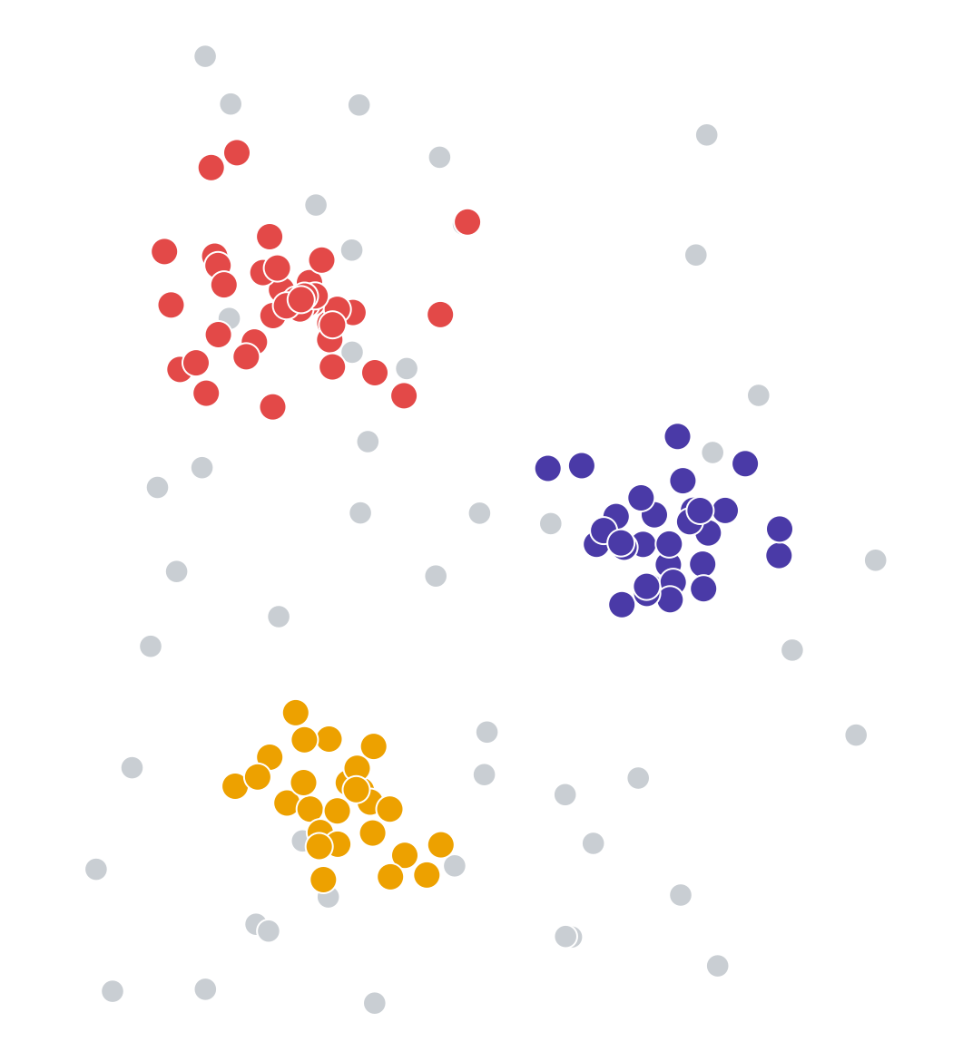
From Text to Financial Impact
RISK
Each description becomes a point, each group a named family, and each family a share of our losses and provisions
1
Free text incident descriptions
2
Clusters machine learning
3
Named families and their weight GenAI + loss data
“Client disputes the interest rate applied to his mortgage after the annual review…”
Share of total gross loss and provisions
Interest rate disputes
Interest rate disputes
22%
12%
“Customer claims the rate calculation on her loan is wrong and asks for a refund…”
Card fraud
6%
Card fraud
3%
›
LLM
Payment processing errors
14%
19%
“Card used fraudulently abroad after the customer's details were stolen online…”
names each
cluster
KYC / onboarding gaps
9%
5%
IT system outages
4%
“Payment sent twice to the same beneficiary following a manual entry error…”
2%
Payment processing errors
Gross loss
Provisions
Why it matters: frequency is not severity. A family can be small in number of incidents and heavy in losses — ranking families by financial weight shows where mitigation pays off first.
BNP PARIBAS
The bank for a changing world
Classification : Internal
Notes:
This slide shows the journey of the data, left to right.
On the left, the raw material: free-text incident descriptions. Notice the first two. They are worded differently, but they describe the same problem, a dispute over an interest rate.
In the middle, what the machine learning does. Each description becomes a point, and descriptions with the same meaning land close together. The two interest rate incidents end up in the same group even though they share few words.
Then the GenAI step: the LLM reads each group and gives it a name.
On the right, the reason this matters for the business. Once every incident belongs to a named family, we can add up the gross loss and the provisions per family. Frequency is not severity: a family can be small in number of incidents and heavy in losses. Ranking families by financial weight shows where mitigation pays off first.
TO UPDATE BEFORE PRESENTING (made-up values): the five family names, the loss and provision percentages in the chart, the four incident quotes, and the cluster map drawing.

